Slide 1
Distributed Development Environment v2.0

Slide 2
Our mission is to create a system that enables developers to professionally deliver high quality and high value software in a repeatable fashion on a daily basis.

Slide 3
Chartering
Requirements
Coding
Building
Deploying
Testing
Release

Slide 4
2-5 min
3-5 min
Retrieve Work
Write Code
Upload Work

Slide 5
0 min
0 min
Retrieve Work
Write Code
Upload Work

Slide 6
Chartering
Requirements
Write Code
Building
Deploying
Testing
Release

Slide 7
Retrieve Current Code
Verify Code
Build Project

Slide 8

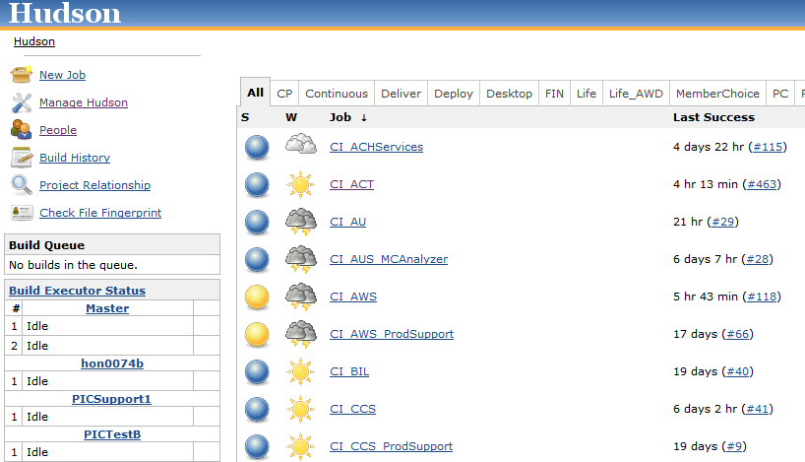

Slide 9
Chartering
Requirements
Write Code
Deploying
Testing
Release

Slide 10
Allocate Resources
Request Deployment
Upload Package

Slide 12
Chartering
Requirements
Write Code
Testing
Release

Slide 13
Questions?

Slide 14
Have you noticed…..
Developers talking about version numbers?
System IDs?
New problems occurring that we didn’t have before?
More collaboration?
Happier developers?

Slide 15
Expectations
Developers commit code with good comments (including WO# or Jira IDs).
Every release needs to be accompanied by release notes showing the changes made.
Project should be under threshold for PMD/Findbugs metric. i.e. no stormclouds
See number of unit tests on project going up.

Slide 16
What’s next?
More focus on unit testing and testing metrics.
Dependency Management System.

Slide 17
